Slide 1




USDC Information Technology Center of Excellence (IT-CoE)
Topic: CompTIA Security+ Testing Review
Orlando, FL
Mechanicsburg, PA
Gilbert, AZ

Slide 2
Identity and Access Management
Session 7
Security+
CompTIA Security+
Test: SYO-601
EXAM OBJECTIVES (DOMAINS)
The table below lists the domains measured by this examination and the extent to which they are represented:
Domain | Weight
1.0 Threats, Attacks and Vulnerabilities | 24%
2.0 Architecture and Design | 21%
3.0 Implementation | 25%
4.0 Operations and Incident Response | 16%
5.0 Governance, Risk, and Compliance | 14%
Total | 100%
Session 7
Includes Objectives from Domains 2 and 3
Objective 2.4 – Summarize authentication and authorization design concepts.
Objective 3.7 – Given a scenario, implement identity and account management controls.
Objective 3.8 – Given a scenario, implement authentication and authorization solutions.

Slide 3
Identity and Access Management
Session 7
Security+
Terminology
CHAP – Challenge Handshake Authentication Protocol – An authentication protocol that periodically reauthenticates to an authenticating entity.
FAR – False Acceptance Rate – The rate at which a biometric solution allows in individuals that it should have rejected.
FRR – False Rejection Rate – The rate at which a biometric solution rejects individuals it should have allowed.
CER – Crossover Error Rate – The point at which the FRR and FAR are equal. Describes the overall accuracy of a biometric system.
Kerberos – An authentication protocol developed at MIT that uses tickets for authentication.
Least Privileges – The principle that any user or service should be given only enough access privileges to do its job and no more.

Slide 4
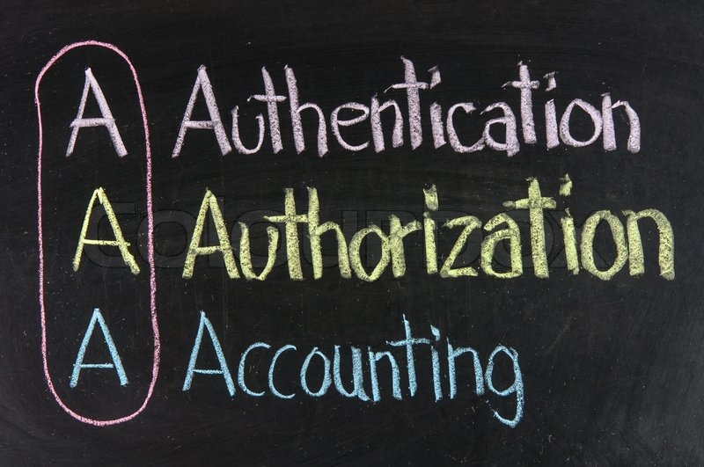
Identity and Access Management
Session 7
Security+
Identity and Access Management Concepts
Authentication
The process of proving who you claim to be.
Something you know
Something you have
Something you are
Something you do
Somewhere you are (geolocation)
Authorization
The process of determining if a user has the rights to access a requested resource. Access Control types:
Discretionary Access Control (DAC)
Mandatory Access Control (MAC)
Role-based Access Control (RBAC)
Accounting
Tracks and measures the resources and data access that a user consumes during their access to the system. This is done through extensive logging of all of the user activities to validate the access and usage is appropriate.
The AAA Access Framework

Slide 5
Identity and Access Management
Session 7
Security+
Identity and Access Management Concepts
Access Authentication Methods
Something you know – such as a password or PIN
Something you have - such as a smartcard, token, or identification device
Something you are - such as fingerprints, retinal pattern, (called biometrics)
Something you do – the action that you take to complete authentication
Somewhere you are – based on geolocation

Slide 6
Identity and Access Management
Session 7
Security+
Identity and Access Management Concepts
Single Factor Authentication
A single form of authentication is required to login and gain access.
This is typically the traditional username/password
Multifactor Authentication
Two or more forms of authentication is required to login and gain access.
This could be username/password combined with a MFA access pin.
Or smartcard and pin/passphrase
Multifactor Authentication refers to two factors or three factors or more for authentication.

Slide 7
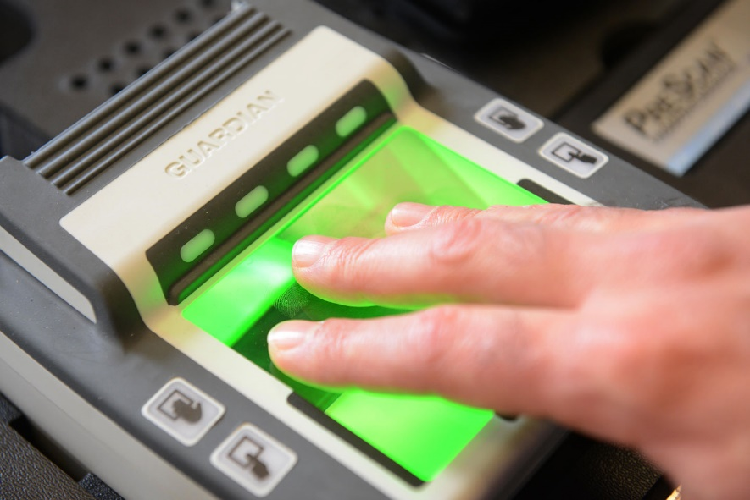
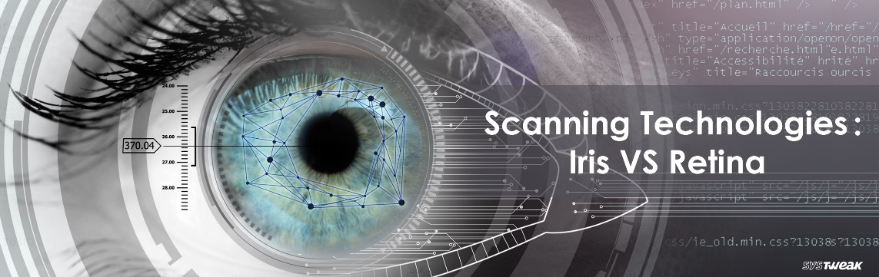
Identity and Access Management
Session 7
Security+
Identity and Access Management Concepts
Biometrics
Something you are
Fingerprint scanners
Full hand scanners
Eye scanners (retinal and iris)
Facial recognition
Voice recognition
Metrics for how well biometrics are working:
FAR – False Acceptance Rate
FFR – False Rejection Rate
Point at which the FAR and FFR are equal
CER – Crossover Error Rate
EER – Error Equal Rate
Adjust sensitivity of the biometric so that both values are equal (FAR/FFR).

Slide 8
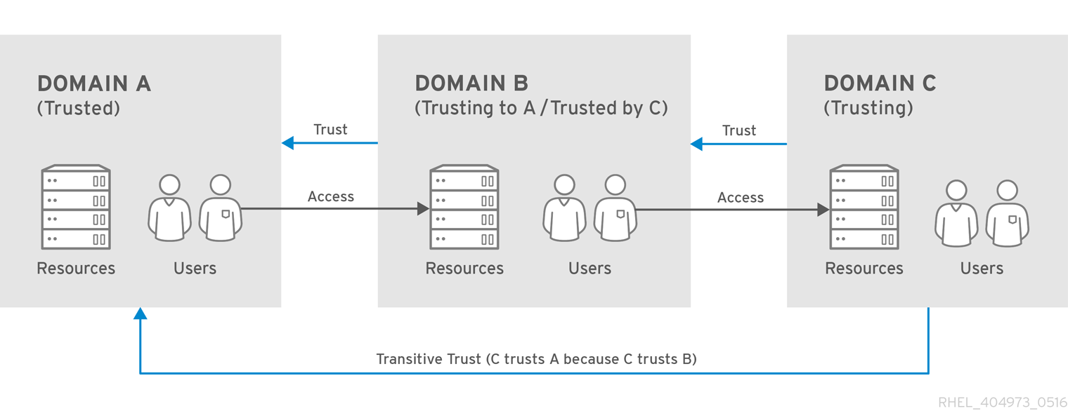
Identity and Access Management
Session 7
Security+
Identity and Access Management Concepts
Directory Federations and Access
Authentication is validated against a database of users such as Active Directory. (an X.500 based directory).
Federated identity – links a user’s identity and their privileges in a way that can be used across business boundaries. (Not Single Sign-On)
A transitive trust can be set up between different Active Directory Domains to allow users access to resources in multiple domains with one user account.

Slide 9
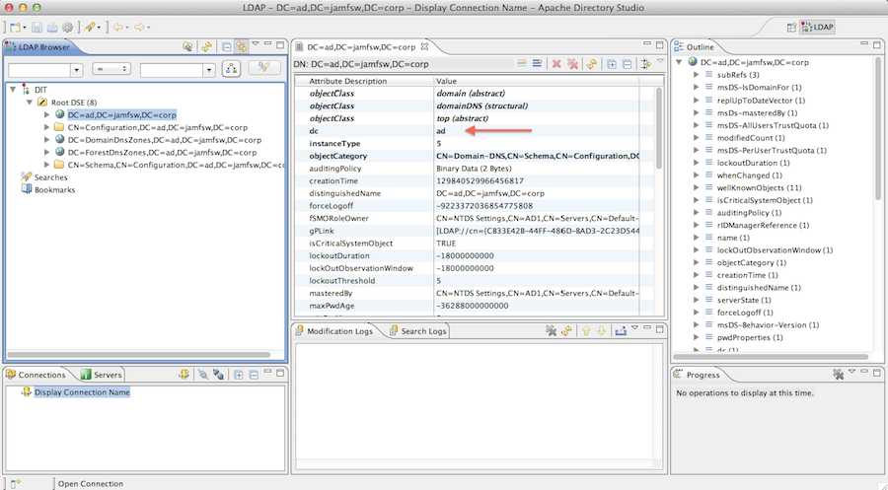
Identity and Access Management
Session 7
Security+
Identity and Access Management Concepts
LDAP
Lightweight Directory Access Protocol
A standardized directory access protocol that allows queries to be made to a directory database such as Active Directory .
Operates by default on Port 389
Secure LDAP is encrypted with SSL/TLS and operates on Port 636.

Slide 10
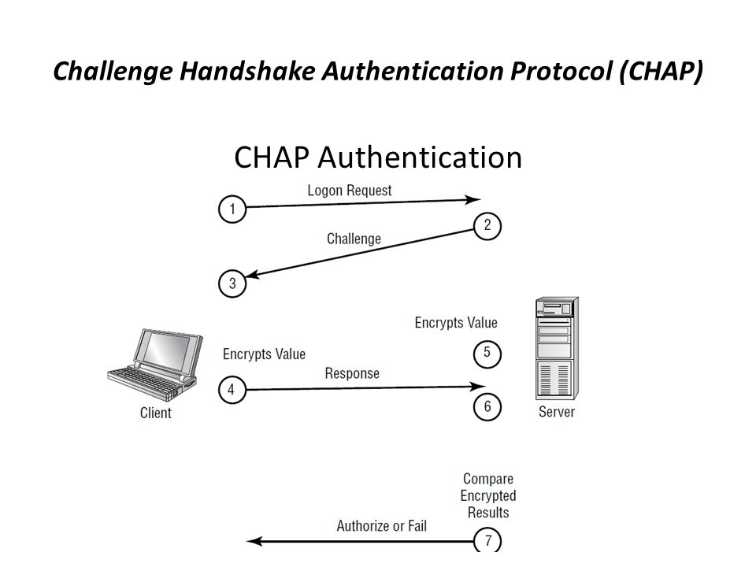
Identity and Access Management
Session 7
Security+
Identity and Access Management Concepts
Authentication Protocols
PAP – Password Authentication Protocol – original protocol, not secure, not used anymore
SPAP – Shiva Password Authentication Protocol encrypts the username and password.
CHAP – Challenge Handshake Authentication Protocol is the current authentication protocol. Username/password is encrypted when sent to the authentication server. The authentication server generates an encrypted random number and sends it back to the client after authentication. This encrypted random number is periodically validated between the client and server to validate the connection.
Microsoft version of CHAP is MS-CHAP. MS-CHAP is not considered secure because it uses DES for encryption which is a weak encryption cypher.

Slide 11
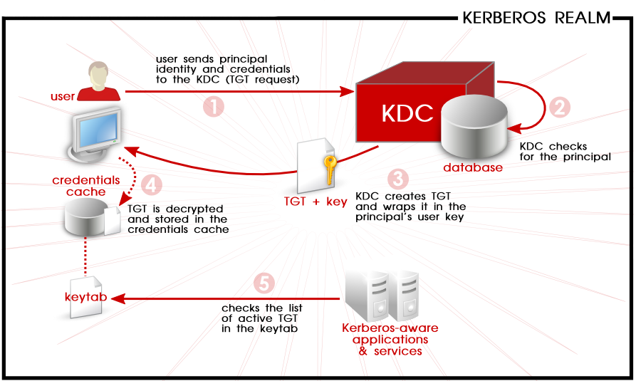
Identity and Access Management
Session 7
Security+
Identity and Access Management Concepts
Kerberos Authentication
An authentication protocol originally designed at MIT, allows for secure single sign-on to a distributed network.
Kerberos has three parts: client, server, and a trusted third party (KDS – Key Distribution System)
The KDS has two systems:
Authentication Service : issues ticket-granting tickets for admission to the ticket-granting service.
Ticket-Granting Service : issues client tickets that allow access to specific services.
Kerberos typically uses an LDAP directory service to store the usernames and passwords used for authentication.
Kerberos is available in all major operating systems and is the default security-based authentication process in Microsoft Widows operating systems.

Slide 12
Identity and Access Management
Session 7
Security+
Identity and Access Management Concepts
OAuTH
Open Standard for Authorization is a common method for authorizing websites or applications to access information, without having to give the requestor a password.
This method is used by Amazon, Google, Facebook, Microsoft and Twitter to permit users to share their information with third party applications or websites.
One-Time Passwords
Password is used one time and never used again.
TOTP – Time Based One Time Password. A password is generated and issued but it is only good for a specific period of time. After it is used or the time has expired, it is no longer a valid password.
This type of password is usually used by websites when you ask to reset your password, and a temporary password is sent that has a time limit for use.
HOTP – Hashed One Time Password. These are usually created by physical tokens.
OpenID
An open standard protocol that allows users to be authenticated by co-operating sites. Users must create an account with an OpenID identity provider, and this account will provide access to all websites that use OpenID.

Slide 13
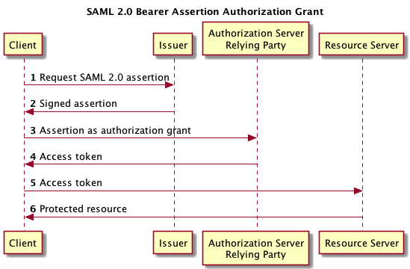
Identity and Access Management
Session 7
Security+
Identity and Access Management Concepts
SAML – Security Assertion Markup Language
SAML is an XML based web service authentication and authorization package passed by the web browser through cookies or url string.
This protocol standard was created and is maintained by OASIS – The Organization for the Advancement of Structured Information Standards.
https://www.oasis-open.org/
SAML is used to exchange authentication and authorization information between identity providers and service providers. It is often used in web browser single sign-on implementations.
Shibboleth is a single sign-on system widely used on the internet that uses SAML. It is used in federated systems that are configured to accept Shibboleth single sign-on.

Slide 14
Understanding Devices and Infrastructure
Security+
Session 3
Designing with Security in Mind
Knowledge Check 2
A company wants to implement an access management solution that allows employees to use the same usernames and passwords for multiple applications without having to keep multiple credentials synchronized.
Which of the following solutions would BEST meet these requirements?
A. Multifactor authentication
B. SSO
C. Biometrics
D. PKI
E. Federation

Slide 15
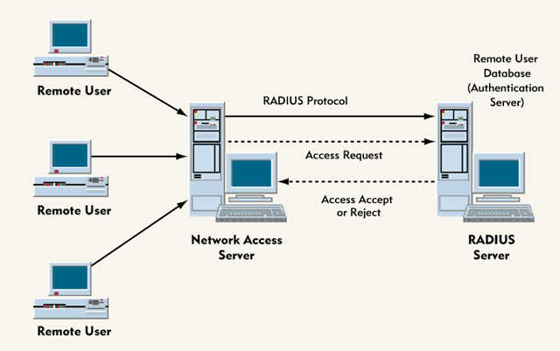
Identity and Access Management
Session 7
Security+
Identity and Access Management Concepts
RADIUS Servers
Remote Authentication Dial-In User Service
Provides authentication for remote access and other network connections. The RADIUS server will validate the authentication request and pass it on through.
RADIUS servers can provide auditing and accounting reporting functions.
Operates over the UDP protocol.
RADIUS communication from the client to the RADIUS server only encrypts the password information and not username, etc. Is susceptible to some attacks.
DIAMETER is an updated version of RADIUS, more secure.

Slide 16
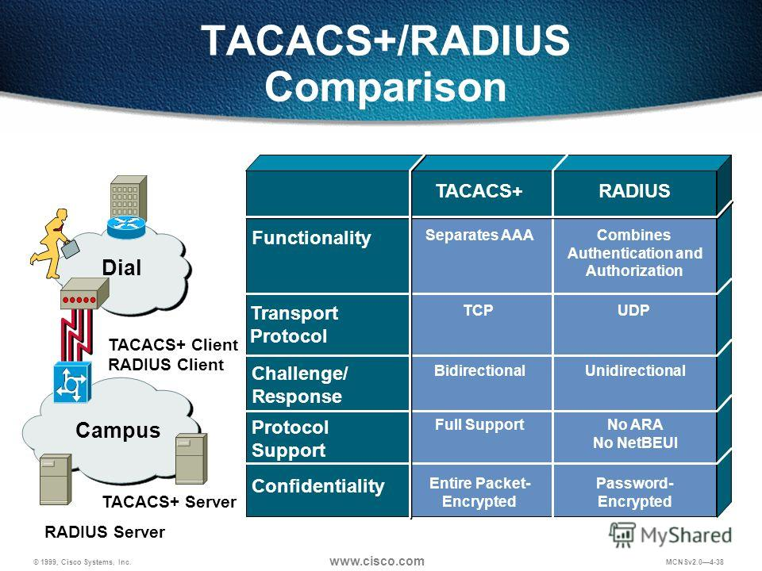
Identity and Access Management
Session 7
Security+
Identity and Access Management Concepts
TACACS, TACACS+, XTACACS
Terminal Access Controller Access Control System
Another protocol for managing remote authentication and other services for network access control through a centralized server.
TACACS+ is the most current version, developed by Cisco for use in their equipment. Uses the AAA (Authentication, Authorization, and Accounting) architecture.
Operates over the TCP protocol.
TACACS+ encrypts all information sent from the client to the TACACS+ server and is inherently more secure than RADIUS.

Slide 17
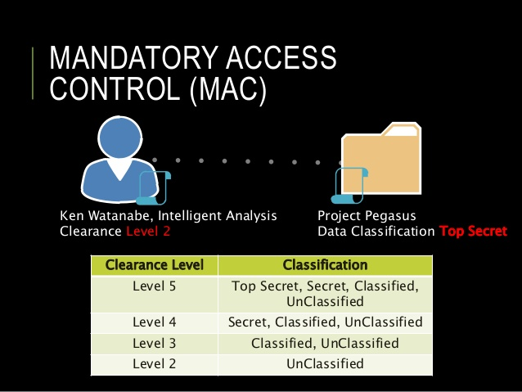
Identity and Access Management
Session 7
Security+
Install and Configure Identity Access Services
Mandatory Access Control (MAC)
Access to data objects is based on the relationship between subject clearance and need to know and object classification level.
Enforced by Security Labels on data objects.
Model is used where confidentiality is the primary factor in data access. Used in government and military classifications (labels) such as Top Secret, etc.

Slide 18
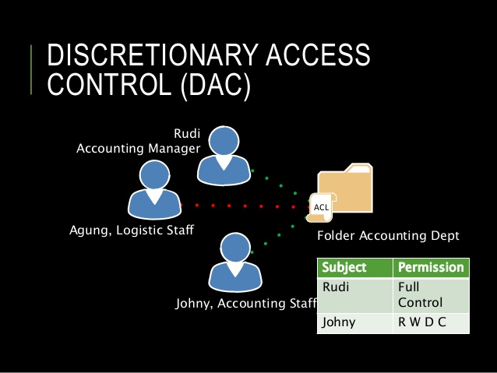
Identity and Access Management
Session 7
Security+
Install and Configure Identity Access Services
Discretionary Access Control (DAC)
Allows the owners of a resource to share their information with other users without management by the Administrator.
Enforced by (ACL) Access Control Lists.
Permissions can be explicitly assigned, or explicitly denied.
Microsoft Windows file/folder access management framework is DAC.
Flexible access control model, but weak on security.

Slide 19
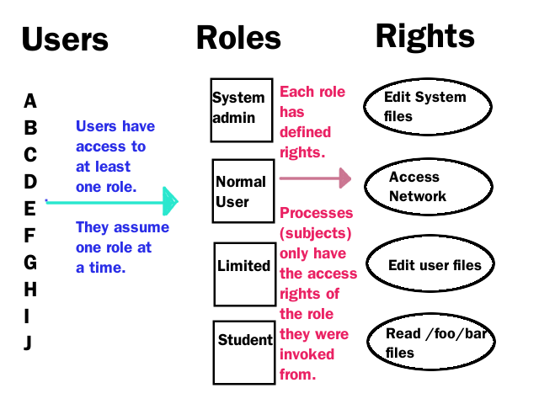
Identity and Access Management
Session 7
Security+
Install and Configure Identity Access Services
Role-Based Access Control (RBAC)
Access is based on the subject’s assigned roles.
Many-to-many relationships are allowed.
Roles are given permissions to data files, and when a user is assigned a role, then all of the permissions of that role is given to the user.
Permissions are given based on ACL lists.

Slide 20
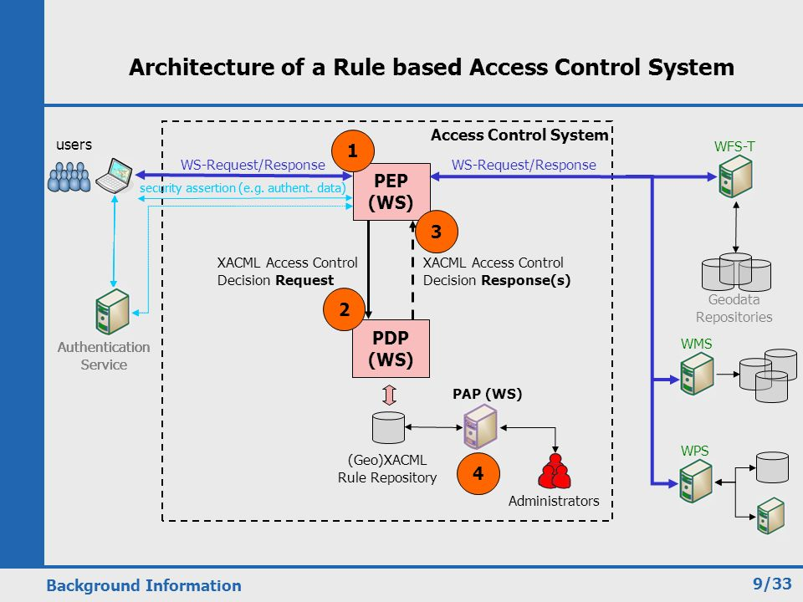
Identity and Access Management
Session 7
Security+
Install and Configure Identity Access Services
Rule-Based Access Control (RBAC)
Access is based on a situational if-then statements.
Rules define an allow list, and a deny list for each data object.

Slide 21
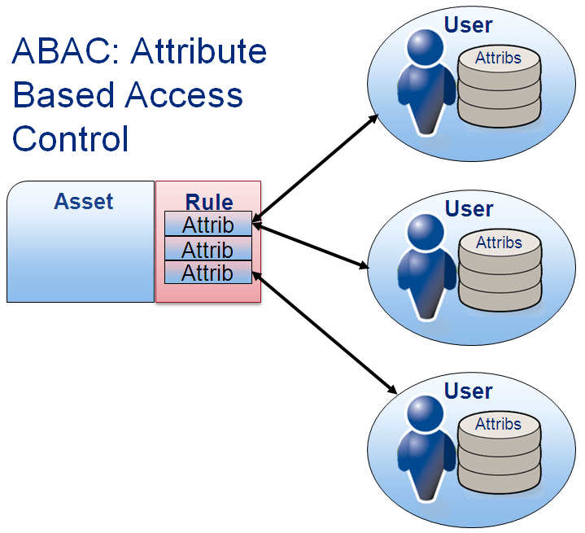
Identity and Access Management
Session 7
Security+
Install and Configure Identity Access Services
Attribute-based access control (ABAC)
Access control model that controls access to objects by evaluating rules against the attributes of entities (both subject and object), operations, and the environment relevant to a request. As defined in NIST-800-162 standard.
Supports a complex Boolean rule set that can evaluate many different attributes to determine if access is granted.

Slide 22
Understanding Devices and Infrastructure
Security+
Session 3
Designing with Security in Mind
Knowledge Check 3
A security administrator wants to implement a company-wide policy to empower data owners to manage and enforce access control rules on various resources.
Which of the following should be implemented?
A. Mandatory access control
B. Discretionary access control
C. Role based access control
D. Rule-based access control

Slide 23
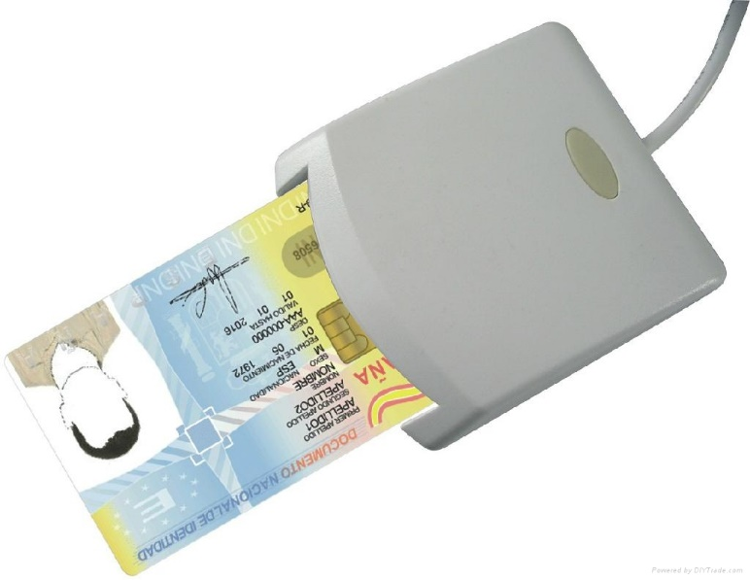
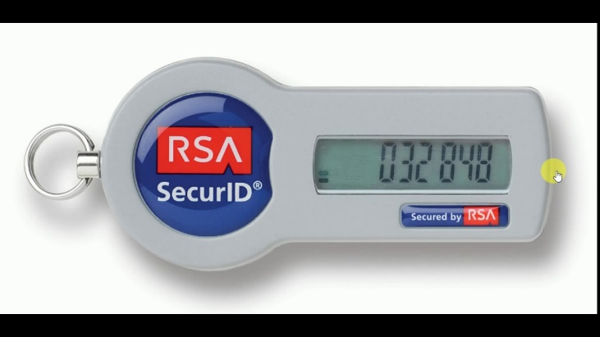
Identity and Access Management
Session 7
Security+
Install and Configure Identity Access Services
Smartcards /Common Access Card
Smartcards are used for identity and access control.
Systems may require a smartcard to access their network, such as the CAC required for access to DoD networks. Smartcards have a chip with a digital certificate and require a PIN for multi-factor authentication. Information on the smartcard is encrypted for further security.
Tokens
Security tokens are an additional form of authentication that is often used for multi-factor authentication. The token generates a pseudo-random one-time passwords that are time limited for use.

Slide 24
Identity and Access Management
Session 7
Security+
Thank You!!
Send questions and slide deck requests to:
Jim Reeves
Security+, CASP+,CySA+, CISSP, ITILv3, CTT+
MCSE, MCSD, MCT
jireeves@Deloitte.com

